Slide 1
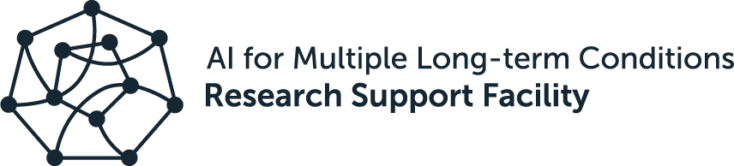
Introduction to version control with git
Rachael Stickland
Data Wrangler, The Alan Turing Institute
21 June 2023
Notes:
This is an introduction for complete beginners. We will start by walking you through what version control is and why it is useful. We will then show you how to use one version control system (git) with a Graphical User Interface (GUI). You will learn basic commands to version control your files locally on your computer.
15 minutes to get to break and questions
-- interactive part at least 1 hour --
5-10 minutes for technical concepts & summaries

Slide 2
Check installation of git and GitHub Desktop
Follow the installation instructions previously shared
Everyone needs:
GitHub Desktop installed:
https://desktop.github.com
Three tutorial data files downloaded to your computer:
https://github.com/aim-rsf/training/tree/main/version-control/super-sandwich-survey
Notes:
You should have got instructions prior to this workshop, so we hope that most of you will have this set up already. However if you’re still having struggles let us know and we can put you in a breakout room with with of the course helpers. The next couple of slides give an overview of me as an instructor, then the learning objectives, then we start with a very broad overview of what version control is.

Slide 3

Introduction to instructor
BSc in Psychology & Research Assistant - File naming for version control PhD in Neuroscience & Neuroimaging - Used GitHub to access other people’s data analysis code & keep track of versions Postdoctoral Research Fellow (Neuroimaging) - Used GitHub regularly to work with my past & future selves - Led creation of GitHub workflow for small research lab - Contributed to open science GitHub projects - Started to share analysis code alongside research publications Data Wrangler at The Alan Turing Institute - Started using GitHub for project management - There is always more to learn …
Rachael
Stickland
Notes:
Here is an overview of my background and my experience with version control
Ask helpers to unmute and introduce themelves briefly

Slide 4
Learning objectives
understand what version control is
understand why version control is useful
understand what git is
understand where you can use git
be able to explain what these words mean in a git context: repo, stage, commit, history, branch (main), amend/undo/revert
be able to apply the above words/commands within a git GUI to version control your files
Notes:
Note to self: Undo is soft reset on the command line

Slide 5
Theory and background
Notes:
I will speak now for about 10-15 mins

Slide 6
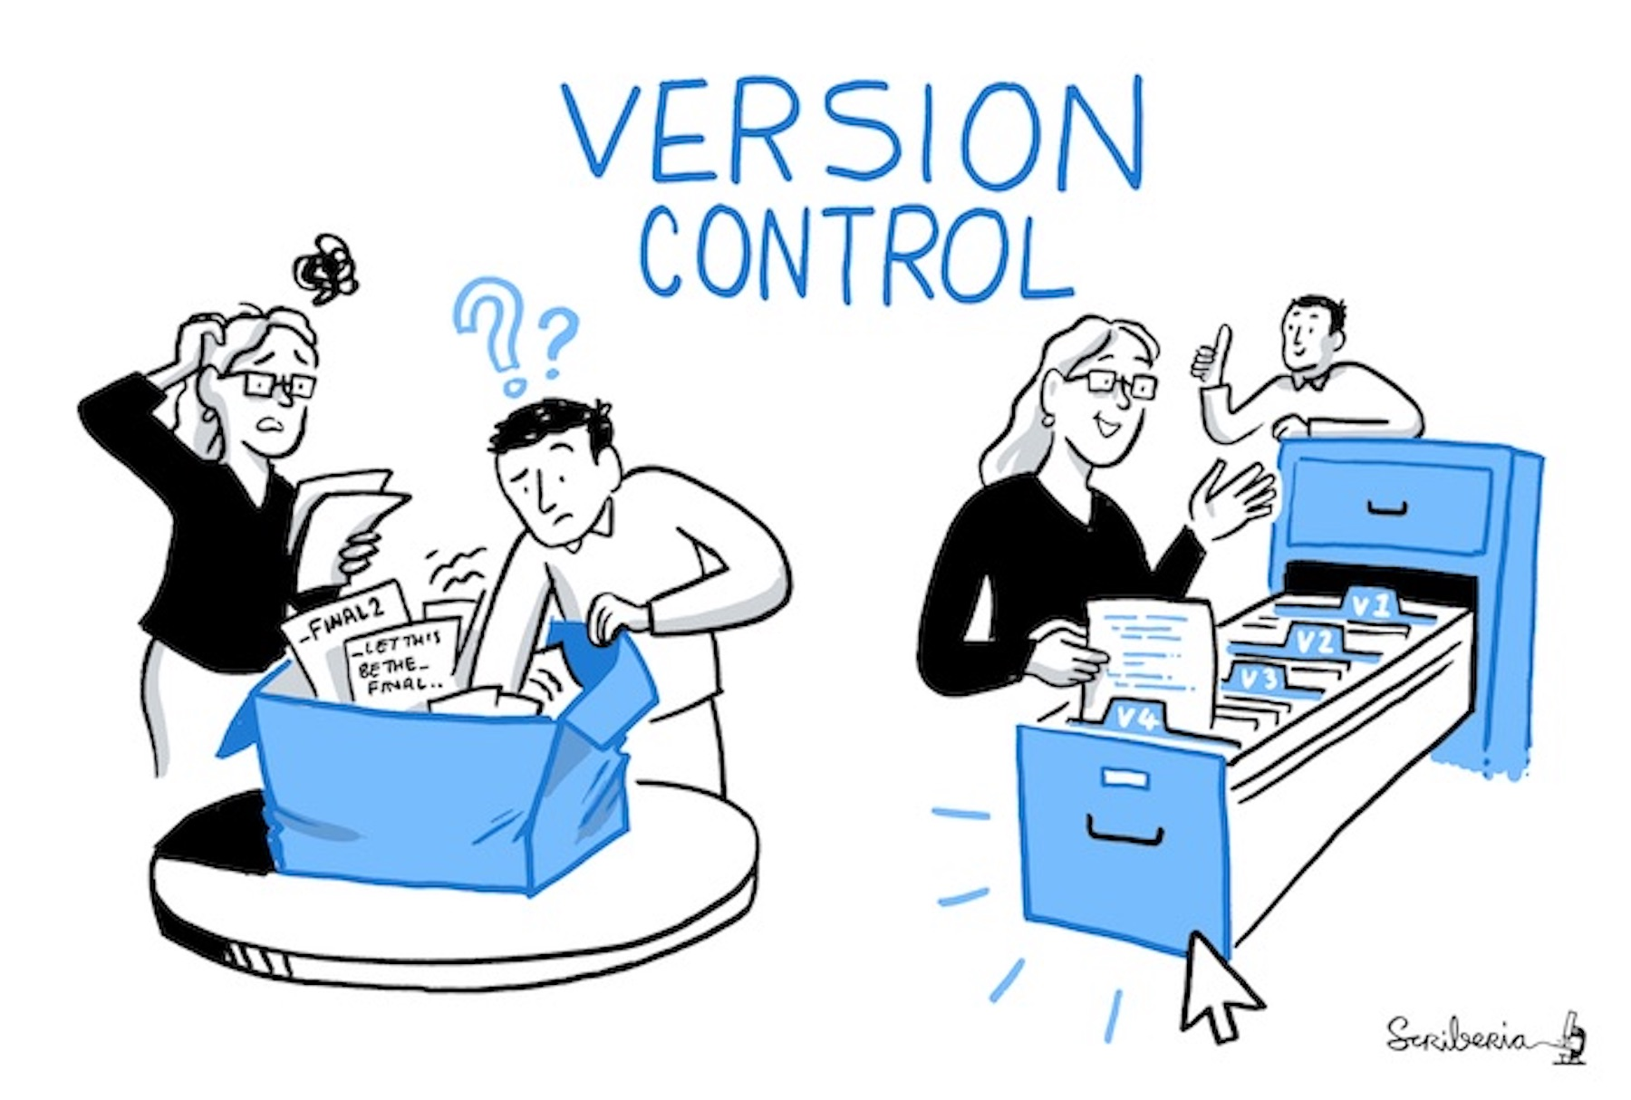
Version control is an approach to recording changes in a file or set of files over time so that you and your collaborators can: track their history, review any changes, and go back to earlier versions.
Version control
What is it Why use it
Challenges
Solutions Solutions (git)
git and GitHub
Created by Scriberia for The Turing Way community (DOI: 10.5281/zenodo.3332807). Quote from the The Turing Way handbook (DOI: 10.5281/zenodo.6533831). Both used under a CC-BY licence.

Slide 7
Version control
Why is version control useful?
It's a great data management and documentation tool
Work with the latest version of a file
Backup previous versions of files
Save edit history (it’s clear what you did & you have the option to revert back)
Test out new features
Collaborate with others and manage projects
What is it Why use it
Challenges
Solutions Solutions (git)
git and GitHub
Notes:
Why it is useful in a broad sense - we will come back to details later

Slide 8
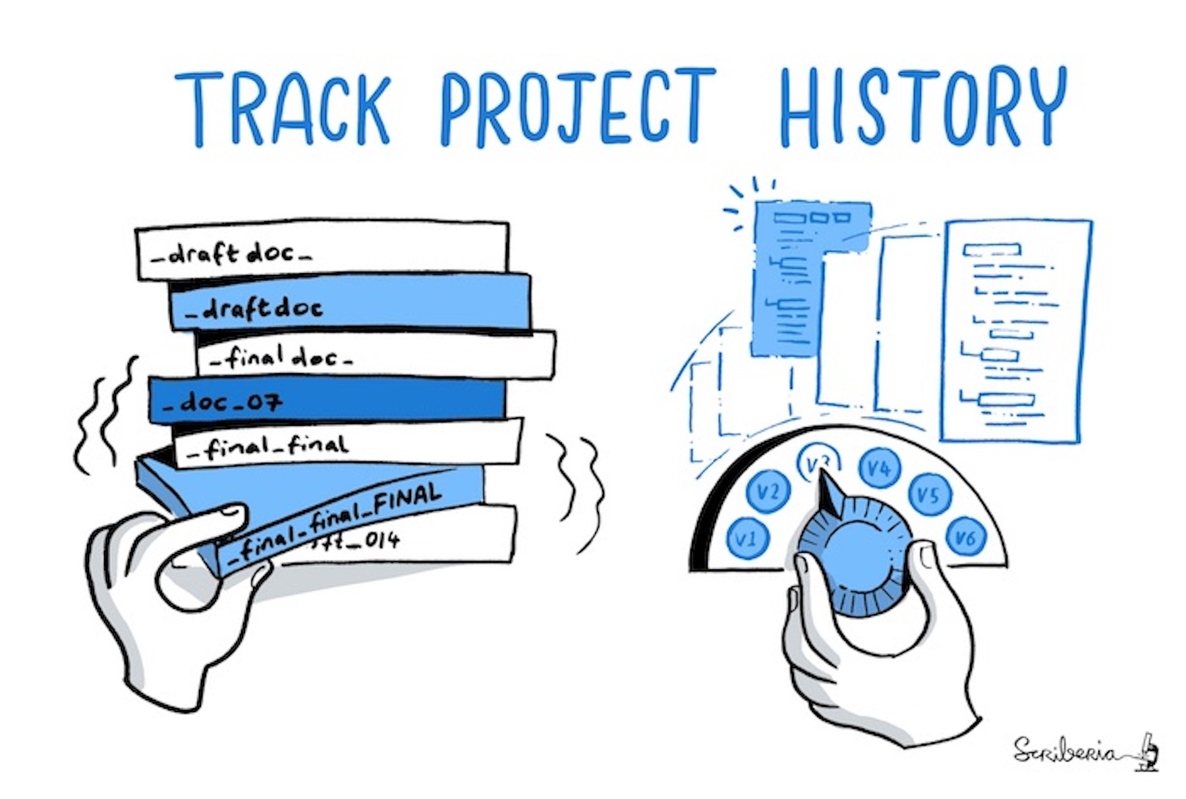
Version control
What is it Why use it
Challenges
Solutions Solutions (git)
git and GitHub
The Turing Way project illustration by Scriberia DOI: 10.5281/zenodo.3332807. Used under a CC-BY licence.
Notes:
It can get messy and complicated when you try to develop a version control system
Should we use file naming, version numbering, something else? Let’s reflect a bit more on the challenges …

Slide 9





Person 3
Suggests a change but doesn’t edit the files
Person 1, 2 & 3
script
script-v2
script-v3
Meta document
Project history
?
Next steps
Person 1
Resources
Person 4
Bugs
Person 2
script-v2_test-new-feature
?
script-workflow
Helps with testing new feature
Time has passed
Where is my latest version of that script?
When did I incorporate that new feature?
Who made that change and why?
Collaborator asked me to run script-v2 …
Slide is intentionally overwhelming & horrible to look at
Notes:
I’ll talk you through a scenario
There is a researcher (person 1) …

Slide 10
Re-use Publish
Person 3
Suggests a change but doesn’t edit the files
Plans
Person 1, 2 & 3
script
script-v2
script-v3
Meta document(s)
Project history
?
Next steps
Person 1
Resources
Person 4
Bugs
Person 2
script-v2_test-new-feature
?
script-workflow
Helps with testing new feature
Don’t worry, there are solutions to these complicated projects!
Slide is intentionally overwhelming & horrible to look at
Scripts
from
elsewhere
Notes:
In reality, it gets even more complicated for most research projects …

Slide 11
Versions in multiple files A straightforward way to version files is by adding versions or explanatory labels to the file name:
v1, v2, v3 etc. draft, commentsAB, etc.
Version control
What is it Why use it
Challenges
Solutions Solutions (git)
git and GitHub
You are probably already doing some form of version control
This may be easy for one file or one user but it can be messy for lots of files and users. More sophisticated version control systems may be needed
Versions in a single file Some software record all the changes in a file, allowing you to explore its history:
Basic: Google Drive, Dropbox, Overleaf
Advanced: Subversion, git

Slide 12
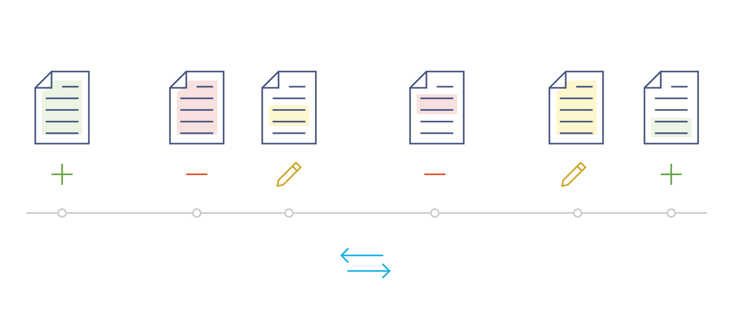
Versions in a single file
Image from Chapter 3 of the Mozilla Science Lab's Study Group Orientation handbook, used under a Mozilla Public License Version 2.0.
Notes:
In a linear workflow, a version control system tracking version within a single file
This is showing it tracking additions, deletions, and changes to existing content
The arrows represent that you can move along this timeline (because you have recorded the changes you can go back to a previous file version)

Slide 13
Version control
Key features of a version control system (VCS)
(SCM)
Source
Code Management
When we edit a file, we want to record:
The content of the edit
When it was edited
Why it was edited
Who edited it
Snapshots of your project will be tracked with a unique code (recording features 1-4). A new file isn’t saved, only the changes made to the file.
File revisions at each snapshot can be compared, restored (and sometimes) merged.
What is it Why use it
Challenges
Solutions Solutions (git)
git and GitHub

Slide 14

Version control
https://git-scm.com
Git is a distributed version control system
There are others, but Git is the most widely used
Created by the Linux development community ‎in 2005
Git is software, mostly written in C
Selling points of Git:
Free, Fast, Open source
Distributed not centralised (everyone has a copy of whole project)
Most operations need only local files and resources
History of changes (who, when, why, what)
Retrieve previous workflow
Foundation to the collaboration tools (GitLab, GitHub)
Git takes snapshots of your project (when you chose), then compares to the previous snapshot & asks you to record why you are making this change.
What is it Why use it
Challenges
Solutions Solutions (git)
git and GitHub
Notes:
You do not have to know C to use git!
Distributed - multiple people can work on the same files at the same time (it has mechanisms for how to merge)

Slide 15

Okay, why the funny name?
Version control
https://git-scm.com
What is it Why use it
Challenges
Solutions Solutions (git)
git and GitHub
The name "git" was given by Linus Torvalds when he wrote the very first version
Torvalds is known for creation/development of the Linux kernel
I'm an egotistical bastard, and I name all my projects after myself. First 'Linux', now 'git'.
https://en.wikipedia.org/wiki/Git
"git" can mean different things, depending on your mood. See the README.md file at https://github.com/git/git for multiple reflections on the name

Slide 16


Version control
A free version control system that lets you manage and keep track of your file history and retrieve previous workflows, locally on your computer.
What is it Why use it
Challenges
Solutions Solutions (git)
git and GitHub
A popular cloud-based hosting service for sharing projects you are tracking with git. Many features for collaborating with others. Good for backups.

Slide 17




How do I interact with git (locally)?
Many many options
Command line / terminal
We won’t be covering this approach but if you are comfortable with the command line check out tutorials & git cheat sheets we’ve shared
Extensions to existing software Your favourite text editor or analytical software is very likely to have a git extension/plugin, often via a GUI.
Examples: Visual Studio Code, R Studio
Specific Git clients (applications with a GUI)
Examples: GitKraken, GitHub Desktop
GUI: Graphical User Interface
Notes:
Very close to the break now

Slide 18
Misconception 1:
git == GitHub
Notes:
Git is the version control system, GitHub is a way of actually using it

Slide 19
Misconception 2:
git is only for code
Notes:
Git is very useful for code but it is not only useful for code
Not only for programmers
For anyone wanting to use version control and work collaboratively
many different file types supported

Slide 20
Misconception 3:
git is only for collaborating
Notes:
Not only for working with others
GitHub’s strength is in helping people collaborate on files
Working with your previous and future self is also very valuable (and is a great way to practice)

Slide 21
Misconception 4:
git does not ‘auto-save’

Slide 22

Common challenge:
Strange new words
Notes:
New words and terminology can take a while to get to know
Be patient with yourself, don’t worry if you have to reference the help sheets or ask us to remind you
Concepts are logical so you will get there eventually

Slide 23
Break & Questions

Slide 24
Interactive part
Let’s going!

Slide 25

Using GitHub Desktop we will:
Create a new repository A repository (or repo) is similar to a folder/directory, where all files are stored for a project. It includes files used by git to track changes. See how git interacts with us when we:
Edit an existing file
Add a new file
Edit multiple files at the same time
Delete a file
Rename a file
View history of our repo
Revert to a previous state
Git calls taking a snapshot (saving your work at a moment in time) a commit

Slide 26
Open up GitHub Desktop
&
Follow along
See HackMD for detailed steps
Notes:
git is very useful for code but we will work with some simpler files in this tutorial to make it more widely accessible, and to learn the principles of git more quickly
This tutorial is silly and is designed to help you have a few different lightweight test files to start your first interactions with git and GitHub, without being too dependent on a specific programming language. It does not mirror best practises when collecting or logging data!

Slide 27
Technical concepts
Notes:
Let’s review some of the steps we covered using the technical language

Slide 28
git concepts & commands: setting up
repo is short for repository. Similar to a folder/directory, this is where all files are stored for a project, including files git uses to track changes
First we ask git to pay attention to our files (initialize a repo, git init)
Git will give us a default branch to work in which is called main
we will return to branches in lesson 2, covering why you might want to create another branch of a different name
moving between branches uses the checkout command

Slide 29
git concepts & commands: making changes
initializing a git repository creates a subdirectory named .git that contains all necessary repository files and logs. But nothing is being automatically tracked! We need to take a snapshot …
When we make a change to a file (addition, deletion, edit) we add it to a staging area (git add), to get it ready for the snapshot to be taken. We can view how it differs to the previous snapshot.
A snapshot in git language is called a commit. This is like pressing the save button.
Once we’ve made all the changes we want, we take a snapshot of the staging area. We write a commit message explaining the motivation for the changes.

Slide 30
git concepts & commands: managing commits
Viewing the git logs shows the history of the repository
Each commit will have four main features attached: a message, a time, a username, and a unique ID
Using commit features we can checkout to previous states, and reset or revert previously applied changes

Slide 31
Summary of lesson 1

Slide 32
Summary
Version control allows us to record changes in a set of files over time
Version control is useful as a data management tool, allowing us to track history, review changes and go back to earlier versions
Git is one of the most widely used version control systems
You can use git locally via the command line, software extensions or git clients (e.g. GitHub Desktop)
GitHub Desktop allows you to interact with git locally using a Graphical User Interface (and facilitates collaboration with others - lesson 2 & 3)

Slide 33

Extra considerations
There are best practices when setting up a new repo (e.g. README file, LICENSE file, .gitignore file) that we did not cover in detail - pick that up in lesson 2
GitHub Desktop is one of the most accessible git clients for getting started but …
It has limitations (staging less explicit, lacks some advance features, less interchangeable)
Use the best tool for your workflow (e.g. command line, software extensions)
Notable limitations of git
Binary files (some spreadsheets, images) - particularly if large
What about datasets?
Resources to help
.gitattributes - tell git how to handle certain files
IDEs to manage databases (e.g. Eclipse) can have version control plug-ins
Git Large File Storage - https://git-lfs.com Data Version Control - https://dvc.org TortoiseSVN - https://tortoisesvn.net
Notes:
If we have time - tell them to look at slides if not
If you are only going to work locally it may not be the best tool - however it can be good to use github.com for your backups anyway! Even if you don’t start by working with others, learning the tools that help you work towards that (GitHub Desktop and github.com) will set you up for when you do.
Limitations -> git is made for text files! There are 2 main ways your computer stores files: as text (human readable) and binary (0 and 1s). Normally, storing as binary files is more efficient for your computer (use less memory & faster) however with git we cannot view the differences in these files so easily. Also, repositories can easily become large (in memory) over time when using binary files - when a change is made it can’t save the difference, so it saves the whole file again in the history. Small and infrequently changed binary files should be fine (e.g. pngs) but larger files that keep getting changed without careful management (e.g. spreadsheets) may cause issues over time.
Version control of datasets/databases can require different workflows. Data is inherently more ‘static’ than documents and code. The files are often large, and binary format. If it’s health data, privacy can also be a concern. Some of the same principles can be used for dataset versioning e.g. data “releases”. However even if it is a text file (like a csv) if you add or change a column it kind of looks like every row has had a change … so conceptually something is a bit off.
IDE = integrated development environment (an environment to develop software, has text editor and processing functions, e.g. R Studio, Eclipse, Visual Studio Code, Spyder)

Slide 34
Prep for lesson 2

Slide 35

Broad curriculum overview
Lesson 2 & 3 GitHub & Collaboration
Working locally and remotely
Working with yourself & others
Using GitHub Desktop and https://github.com
We used a tool called GitHub Desktop. This allows us to build towards Lesson 2 & 3, however in Lesson 1 we only used GitHub desktop locally (i.e. we did not connect to https://github.com)
Lesson 1 Version Control (with git)
Working locally
Working with yourself
Using GitHub Desktop
Potential
confusion

Slide 36
Further resources
git cheat sheets and training manuals: https://training.github.com
GitHub Desktop documentation: https://docs.github.com/en/desktop
Git guides: https://github.com/git-guides AIM-RSF GitHub repository lists lots of resources and tutorials:
https://github.com/aim-rsf/training/tree/main/version-control

Slide 37
Acknowledgments

Slide 38


Acknowledgments
Eirini Zormpa
Workshop organization
Assistance with lesson planning
Previous slides: https://aim-rsf.github.io/training/github-intro/github-intro-slides
Content / inspiration taken from
https://docs.github.com/en/desktop
https://git-scm.com
https://annakrystalli.me/rrresearch/06_git.html
https://github.com/git-guides
Icons
www.flaticon.com/free-icons
Notes:
Ask thanks to the helpers!

Slide 39
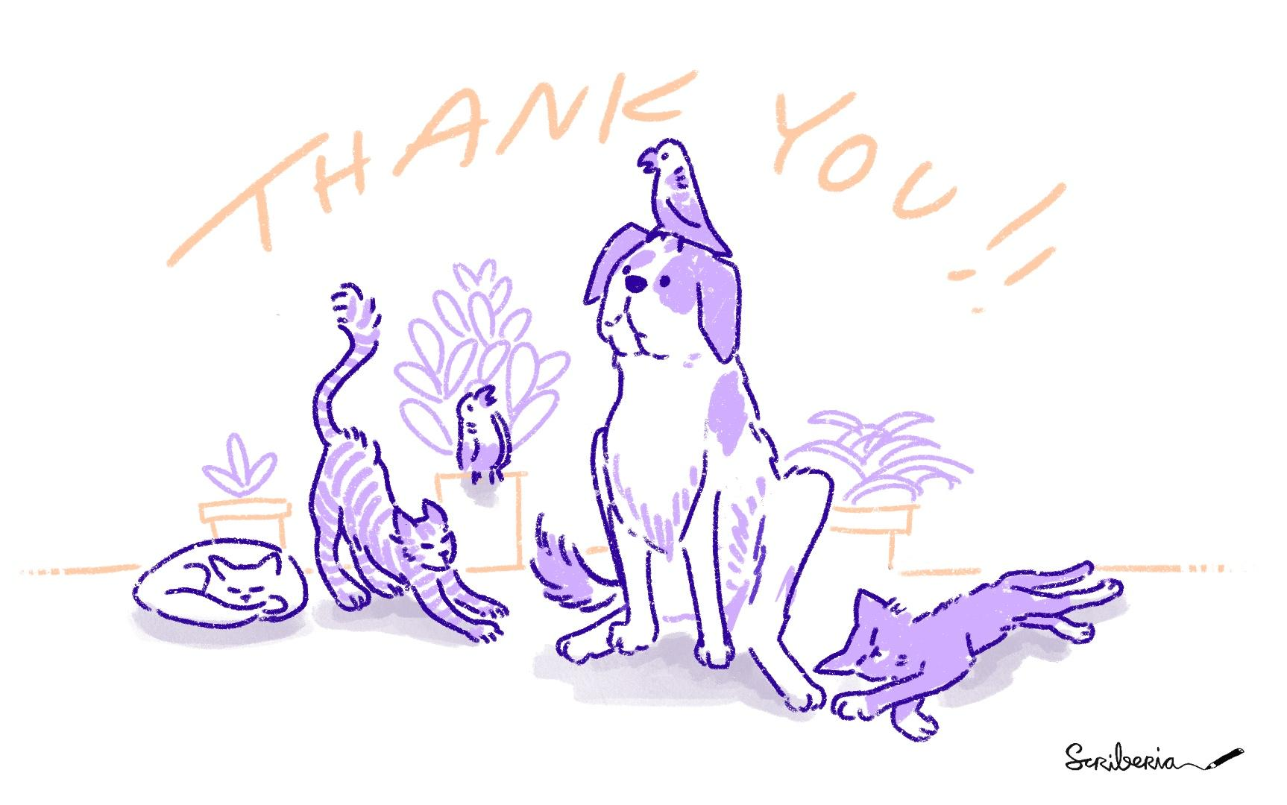
Notes:
Time for questions here

